Slide 1
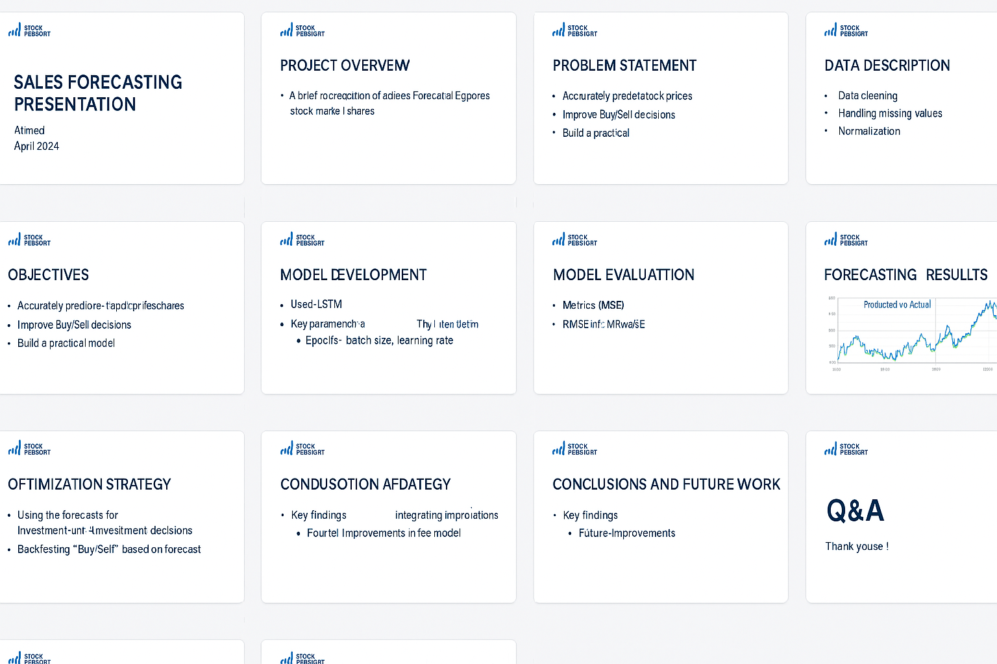
Sales Forecasting and Optimization of POWERGRID Stock Market Shares
Presented by: [Ahmed Hashem, Osama Ghandour, Habeba Ayman]
Date:18/4/2025

Slide 2
Project Overview
This project focuses on predicting stock prices for any companies listed on the stock market.
The aim is to improve investment decisions using machine learning techniques.

Slide 3
Problem Statement
Investors struggle with high volatility and unpredictable price movements.
Need for a reliable model to guide buy/sell decisions.

Slide 4
Objectives
• Forecast stock prices accurately using historical data.
• Optimize investment strategies based on predictions.
• Build a reusable and scalable forecasting model.

Slide 5
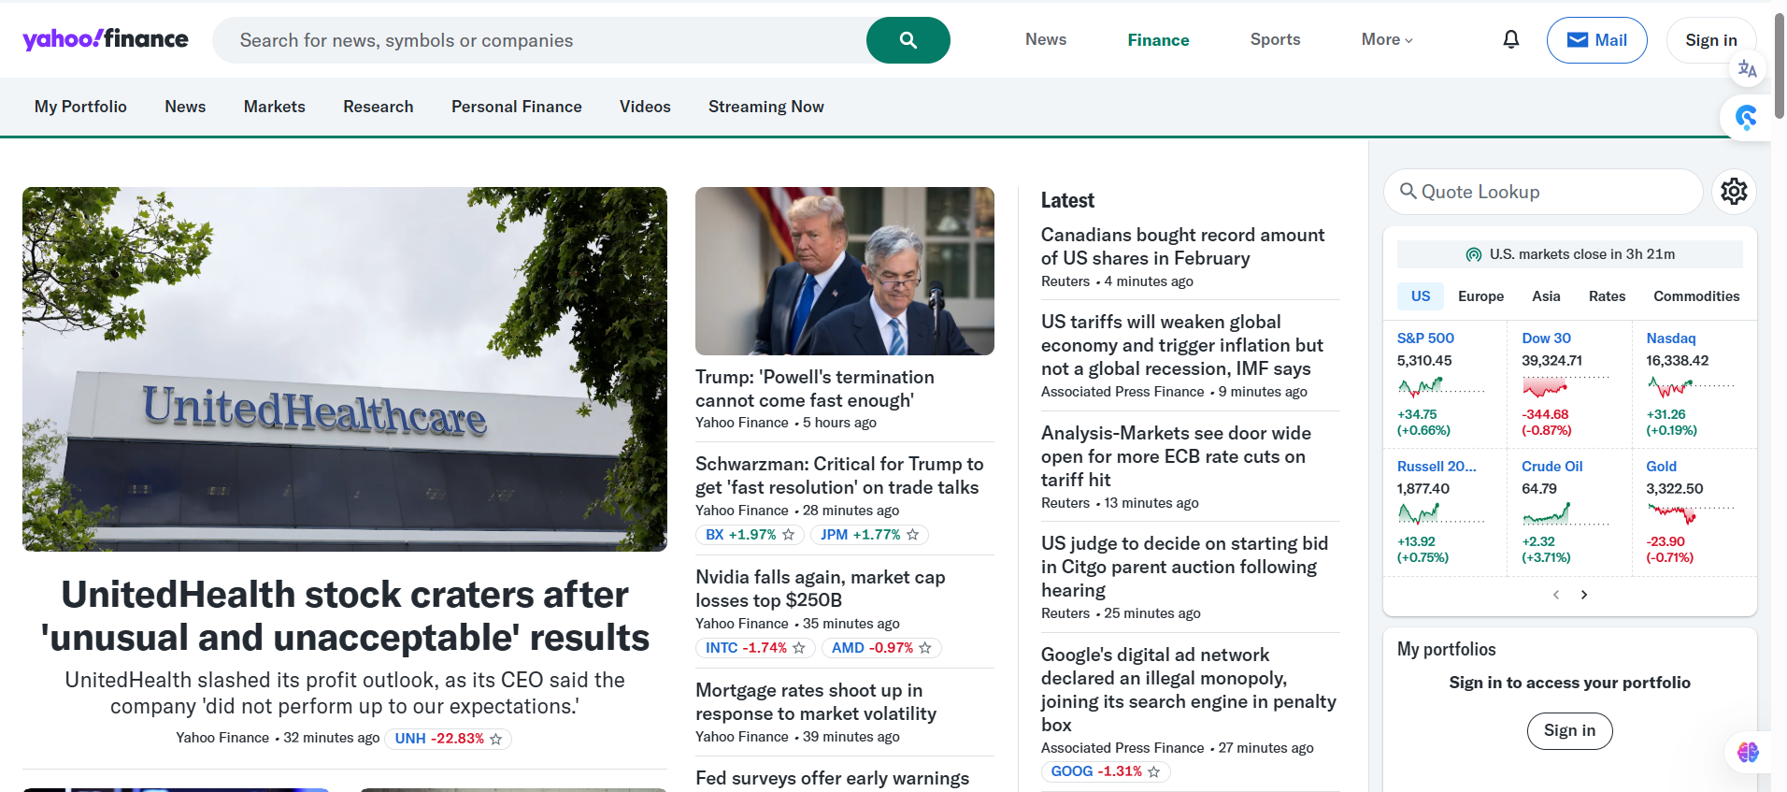
Data Description
• Source: Yahoofinance
• Features: Open, Close, High, Low, Volume
• Time span: Several years of daily stock data

Slide 6
Data Preprocessing
• Handled missing values
Addressed missing entries in the dataset
Ensured clean and consistent data for modeling
Methods used:
Filling with previous/next value
Dropping rows if necessary
• Applied normalization for time-series modeling
Scaled features for better performance in time-series models
Prevented large values from dominating the learning process
Common technique: Min-Max Scaling (values between 0 and 1)
• Created training and test datasets
Split the dataset into:
Training Set: for model learning
Test Set: for performance evaluation
Ensured time-based split to preserve chronological order

Slide 7
1. Exploratory Data Analysis (EDA)
Visualize key trends, seasonality, and outliers
Common plots: line charts, box plots, heatmaps
Helps understand patterns in the data before modeling
2. Feature Engineering
Create new features to enhance model performance:
Moving Averages
Daily Returns
Volatility
Date-based features (day, month, weekday)

Slide 8
3. Model Selection & Building
Choose an appropriate model for forecasting:
Statistical: ARIMA, SARIMA
Machine Learning: XGBoost, Random Forest
Deep Learning: LSTM, GRU
Train the model using the prepared dataset
4. Model Evaluation
Evaluate model accuracy using metrics like:
MAE (Mean Absolute Error)
RMSE (Root Mean Squared Error)
MAPE (Mean Absolute Percentage Error)
Compare actual vs predicted values
5. Forecasting Future Values
Use the trained model to forecast future stock prices
Plot predictions vs actual prices to visualize performance

Slide 9
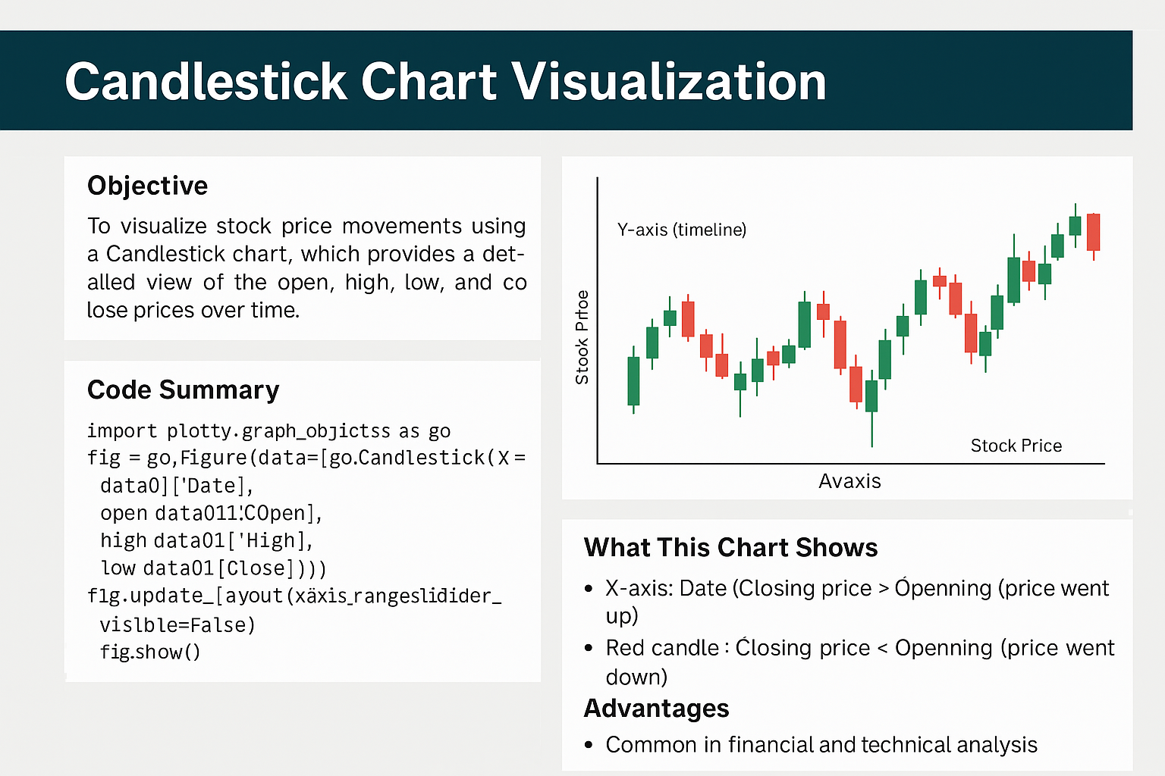
📊 Candlestick Chart Visualization
Objective:
To visualize stock price movements using a Candlestick chart, which provides a detailed view of the open, high, low, and close prices over time.

Slide 10
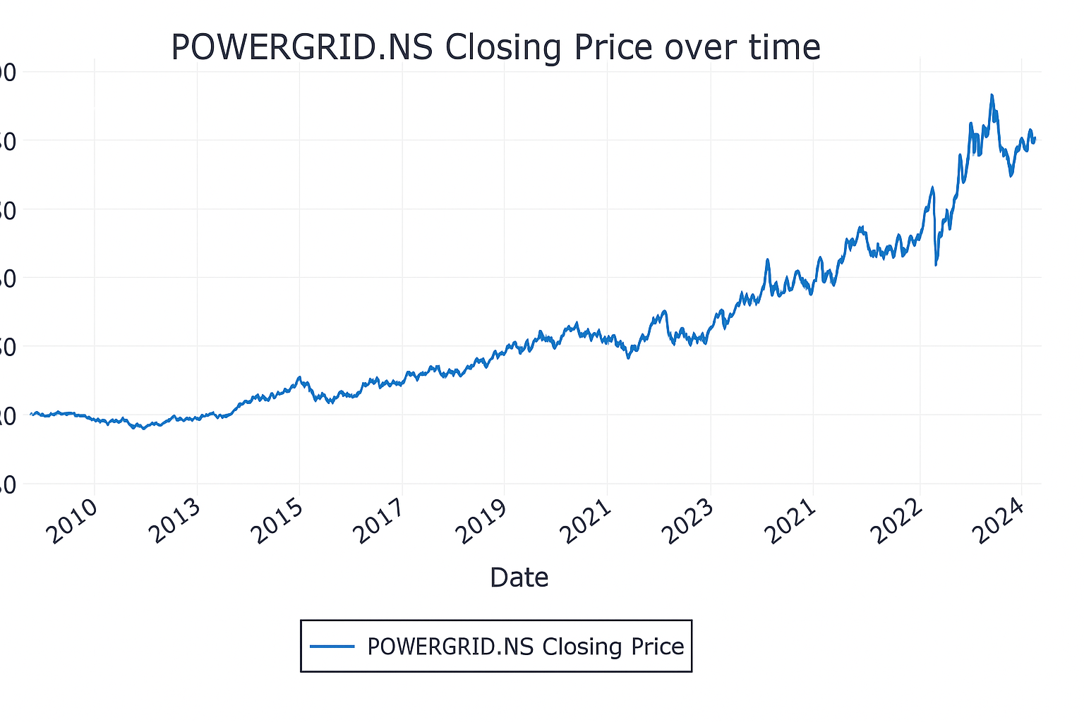
📈 Line Chart – Closing Price Over Time
Description:
This line chart visualizes the closing price of the stock
(POWERGRID.NS) over time.
It provides a clear overview of the stock’s performance and long-term trend from the start date to the present.

Slide 11
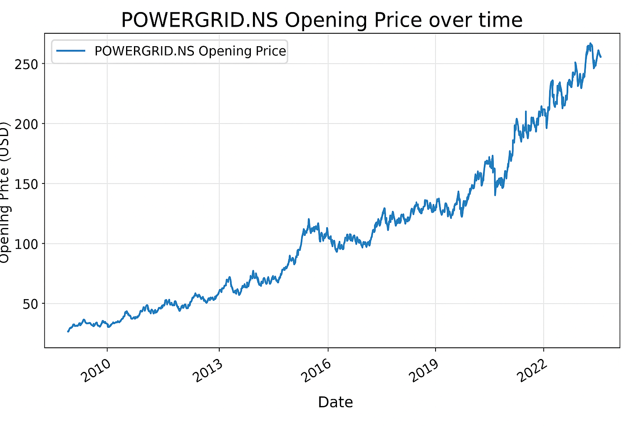
Line Chart – opening Price Over Time
Line Chart – Opening Price
Displays daily opening price of POWERGRID.NS
X-axis: Date
Y-axis: Opening Price (USD)
Tracks market open prices over time
Helpful for analyzing early trends and movements

Slide 12
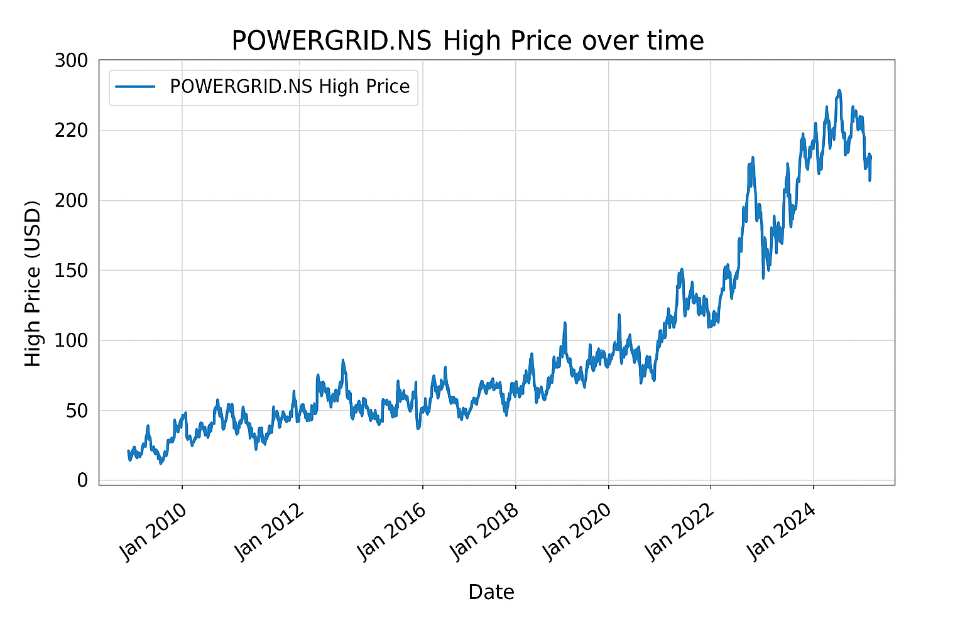
Line Chart – High Price
Displays daily high price of POWERGRID.NS
X-axis: Date
Y-axis: High Price (USD)
Shows the highest price reached during each trading day
Useful for identifying price peaks and market volatility

Slide 13
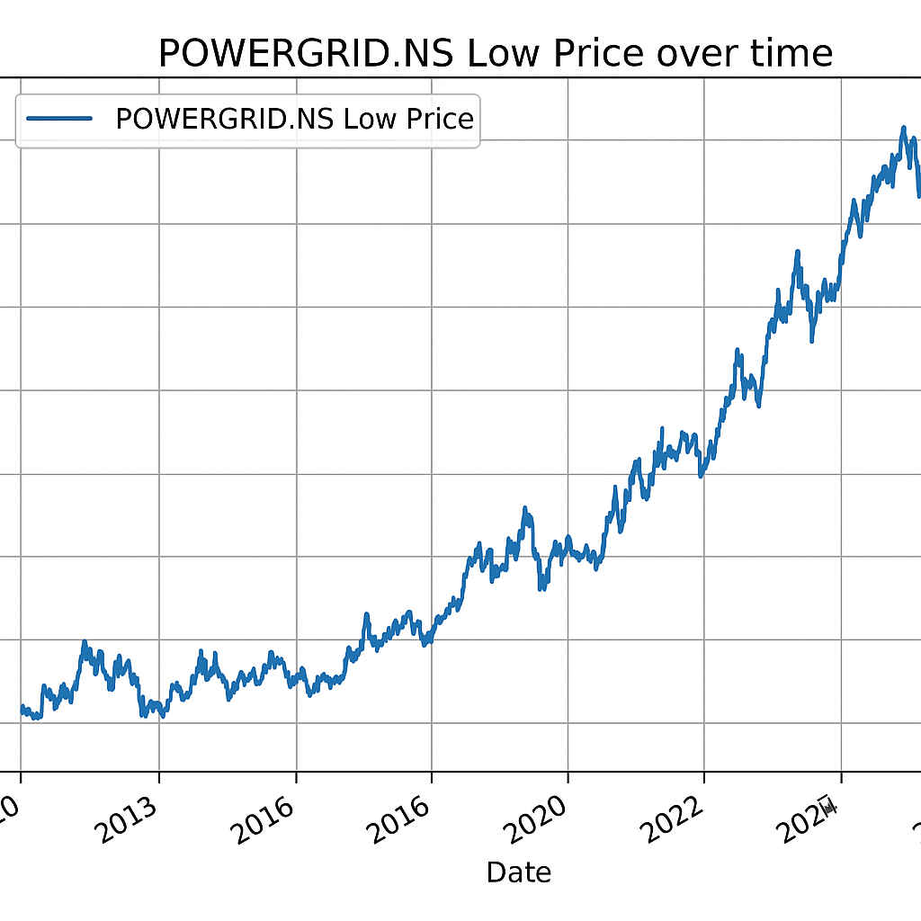
Line Chart – Low Price
Displays daily low price of POWERGRID.NS
X-axis: Date
Y-axis: Low Price (USD)
Shows the lowest price reached during each trading day
Useful for identifying price troughs and market lows

Slide 14
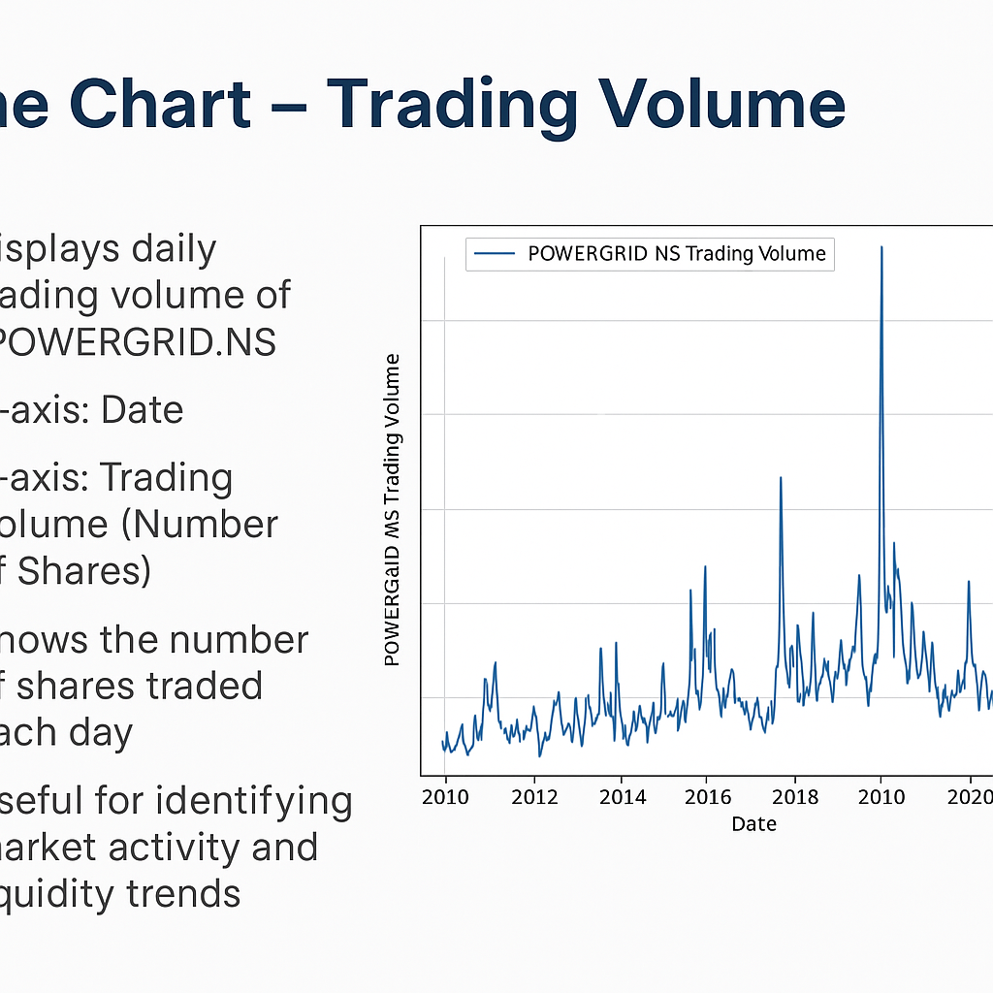
Line Chart – Trading Volume
Displays daily trading volume of POWERGRID.NS
X-axis: Date
Y-axis: Trading Volume (Number of Shares)
Shows the number of shares traded each day
Useful for identifying market activity and liquidity trends

Slide 15
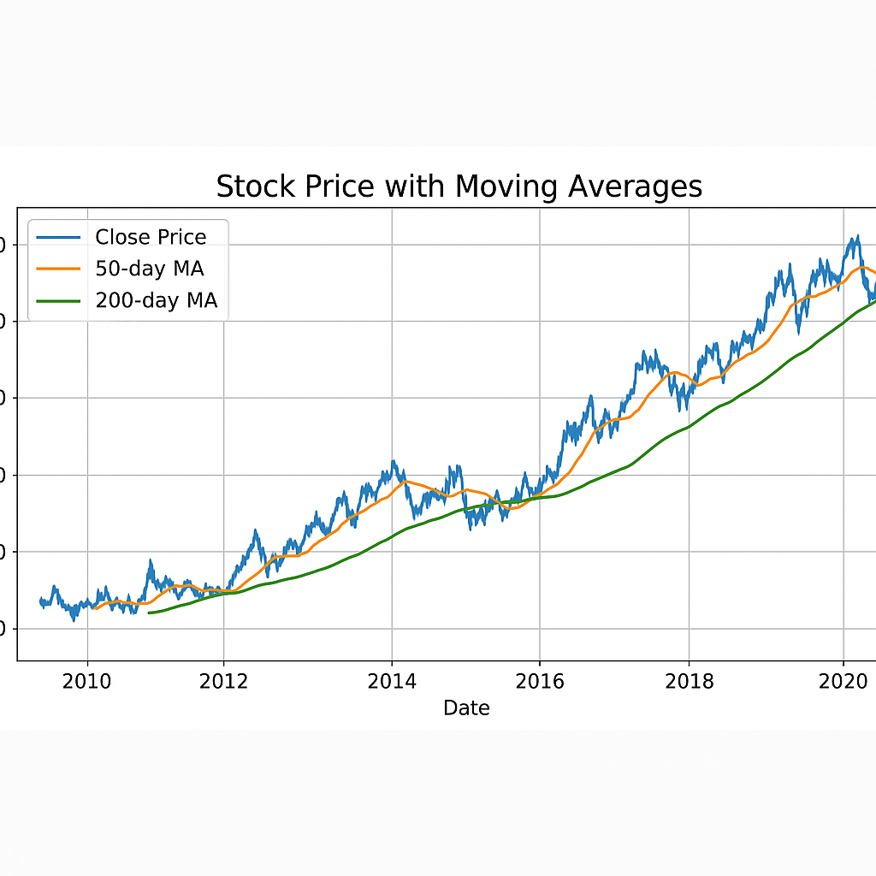
Stock Price with Moving Averages
Displays the Closing Price along with two Moving Averages:
50-day MA: Short-term trend indicator
200-day MA: Long-term trend indicator
X-axis: Date
Y-axis: Stock Price (USD)
Moving Averages help smooth price data and highlight trends over time
Useful for identifying buy/sell signals and market direction

Slide 16
Model Development
Data Splitting for LSTM Model
The dataset is split into two parts:
70% for Training
30% for Testing
Only the Closing Price is used for the LSTM model
This separation helps evaluate model performance on unseen data
Prepares the data for time-series forecasting using deep learning

Slide 17
Model Evaluation
• Metrics: Mean Squared Error (MSE), Root Mean Squared Error (RMSE)
• LSTM outperformed basic models
• Forecasts followed actual prices closely
Purpose: To assess the accuracy of the LSTM model in predicting stock prices
Evaluation Metrics Used:
Mean Squared Error (MSE)
Root Mean Squared Error (RMSE)
(Optional) Mean Absolute Error (MAE)
Visual Comparison:
Actual vs Predicted Prices plotted for test dataset
Helps to observe how well the model tracks real market data
Key Insight: Lower error values indicate better prediction performance

Slide 18
Data Normalization
Technique Used: MinMaxScaler from sklearn
Scales the training data into a range between 0 and 1
Helps the LSTM model to:
Converge faster during training
Avoid dominance of large values
Ensures all input features contribute equally to learning

Slide 19
Training Sequence Preparation for LSTM
Created input/output pairs for LSTM:
x_train: Contains past 50 time steps (i.e., previous 50 closing prices)
y_train: Contains the next closing price
Purpose:
To help LSTM learn temporal dependencies in stock price trends
Data reshaped into sequences for time-series forecasting

Slide 20
LSTM Model Architecture
Built using Keras Sequential API
Consists of:
4 LSTM layers with increasing units: 50 → 60 → 80 → 120
Each LSTM layer followed by a Dropout layer to prevent overfitting
Final Dense layer outputs the predicted stock price
Activation Function: ReLU
Input Shape: (sequence length = 50, features = 1)
Designed to capture complex time-series patterns

Slide 21
Forecasting ResultsOriginal vs Predicted Stock Prices
Visual comparison between:
Actual closing prices from the test dataset
Predicted prices generated by the LSTM model
Helps assess model performance and trend accuracy
Good alignment between the two lines indicates the model is effectively capturing market behavior
Useful for identifying how closely the model can track real-world price movements

Slide 22
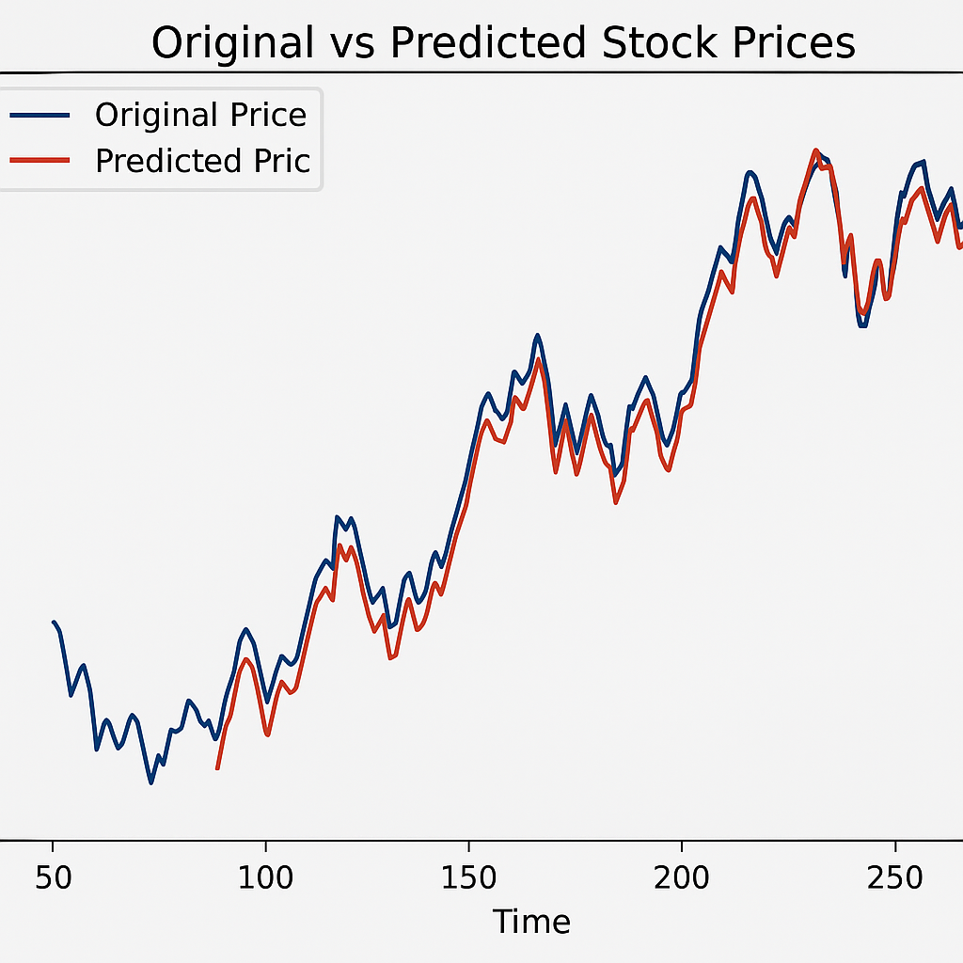

Slide 23
Future Price Prediction & Investment Decision
Predicted 50 future stock prices using the trained LSTM model
Investment Logic:
If the predicted price is more than 5% higher than the last available price, the suggestion is to Buy.
Otherwise, the suggestion is to Not Buy.
Historical vs Forecasted Prices are plotted to visualize how well the model captures future trends.
The investment decision is based on the forecasted price at the end of the prediction horizon.

Slide 24
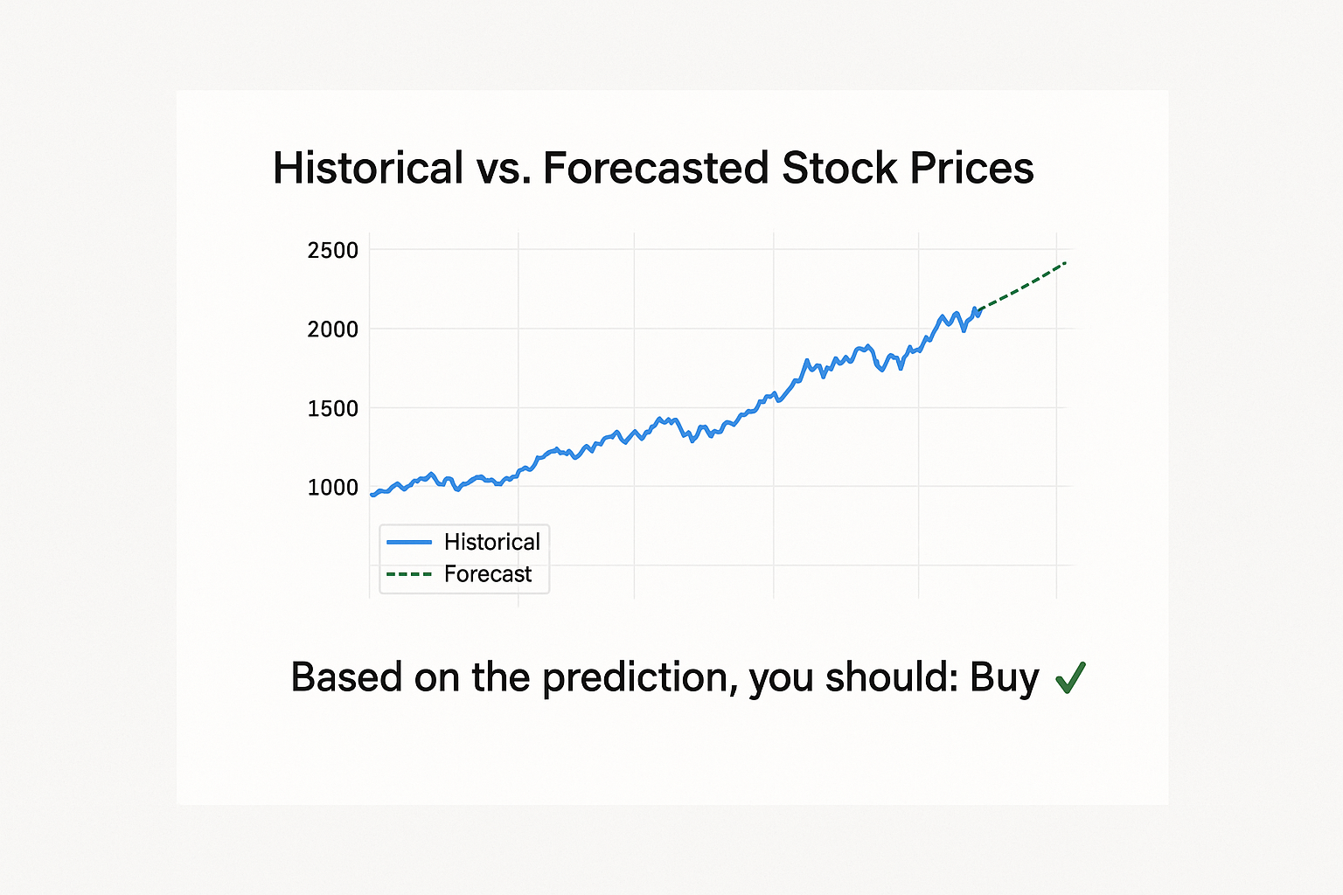
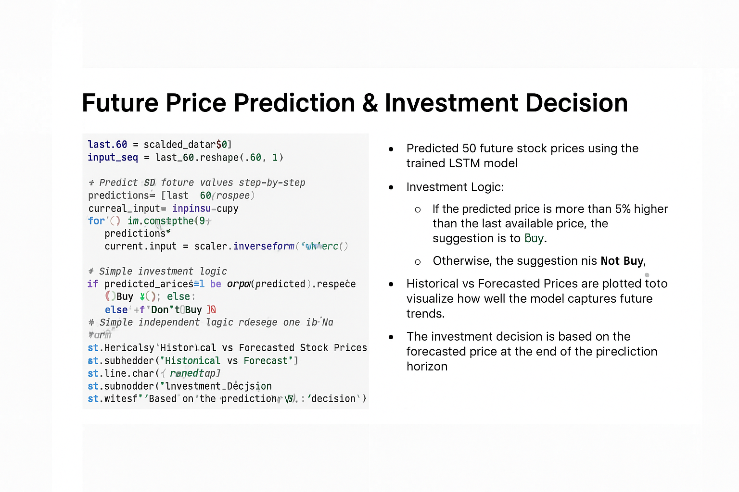

Slide 25
Optimization Strategy
• Simple rule-based strategy: Buy when predicted price rises
• Backtesting showed improved return vs. static strategies

Slide 26
Deployment
• Model saved in .keras format
• Ready for deployment using web tools (e.g., Streamlit)

Slide 27
Conclusions and Future Work
• Accurate forecasts help make informed decisions
• Future: Incorporate sentiment analysis, macroeconomic data
• Improve prediction accuracy with hybrid models

Slide 28
Q&A
Thank you for your attention
Any questions?

